Slide 1
GooGLe PLAYsTORE aNALYSIS

Slide 2
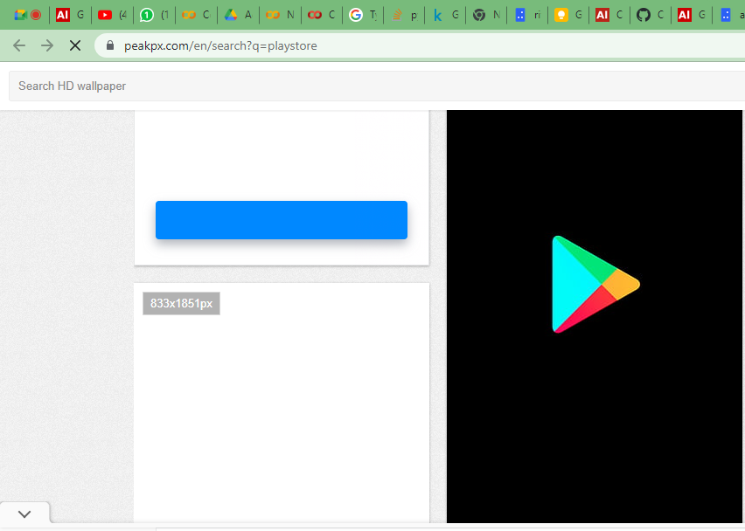
Why Google Play Store Analysis?
In today’s scenario we can see that mobile apps playing an important role in any individual’s life. It has been seen that the development of the mobile application advertise has an incredible effect on advanced innovation.
Having said that, with the consistently developing versatile application showcase there is additionally an eminent ascent of portable application designers inevitably bringing about high as can be income by the worldwide portable application industry.
With enormous challenge from everywhere throughout the globe, it is basic for a designer to realize that he is continuing in the right heading. To hold this income and their place in the market the application designers may need to figure out how to stick into their present position.
The Google Play Store is observed to be the biggest application platform. It has been seen that in spite of the fact that it creates more than two fold the downloads than the Apple App Store yet makes just a large portion of the cash contrasted with the App Store. In this way, I scratched information from the Play Store to direct our examination on it.

Slide 3

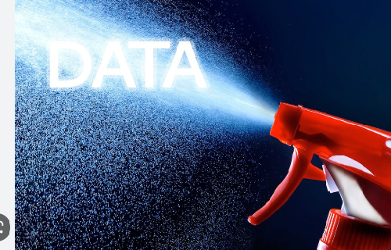

WORKFLOW
COLLECTING DATA CLEANING EXPLORATORY DATA
DATA SET AND ANALYSIS
PREPROCESSING

Slide 4
AGENDA
Collecting Data
Checking the Outliers
Data Cleaning
Distribution of App Rating
Category Wise Rating
Top 10 Category of Apps and No. of Apps in each Category
Distribution of Free and Paid Apps
Distribution According to the Android version of the Apps
Count Plot Graph Summary for No. of Apps in each category
No. of Apps for each Age group
Challenges faces
Conclusion

Slide 5
1. COLLECTING DATA
This step is about getting to know the data and understanding what has to be done before the data becomes useful in a particular context. This can be done by reading the CSV file and doing initial statistical analysis.
Though the dataset may seem to have the correct datatypes for each column, we need to check it. Inconsistent datatypes will create issues while dealing with problems.

Slide 6
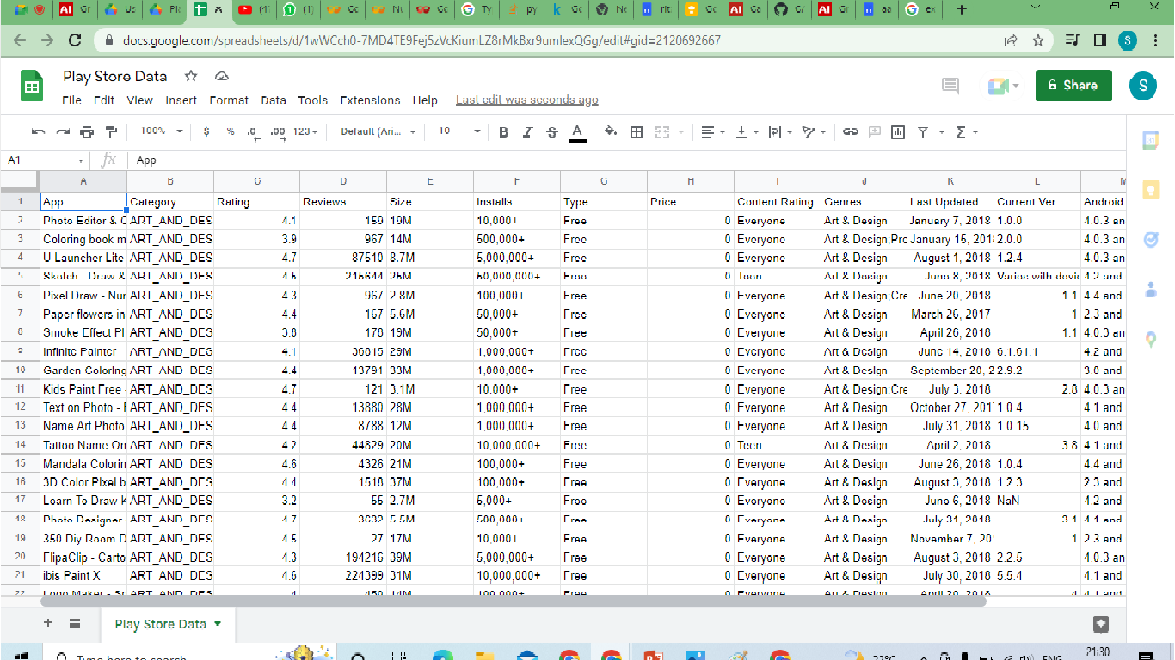
df.csv

Slide 7
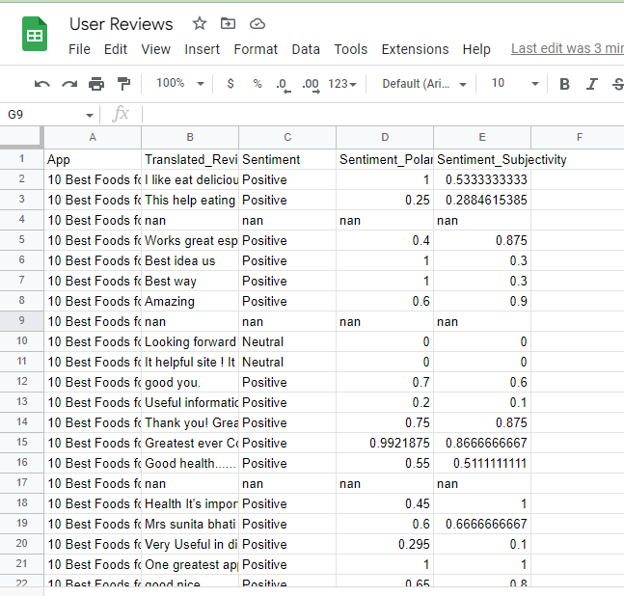
user_reviews.csv

Slide 8
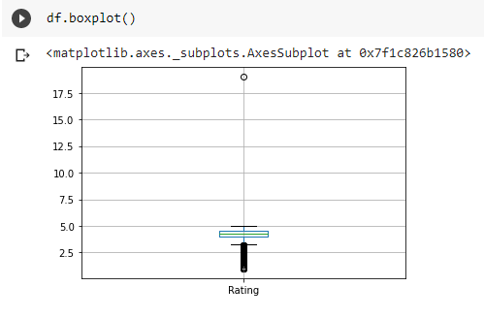
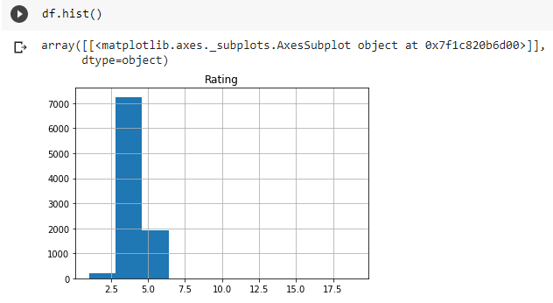
Checking the Outliers
From the boxplot and histogram we can conclude that the rating are going above 5. It means that the rating are not accurate for all the apps. We need to rectify the inaccurate rating by removing the rating above 5.

Slide 9
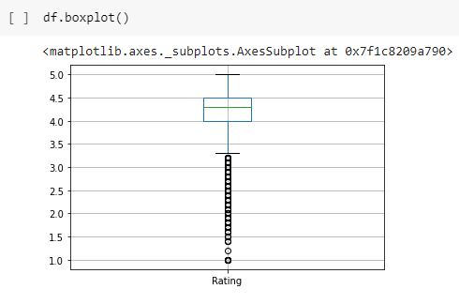
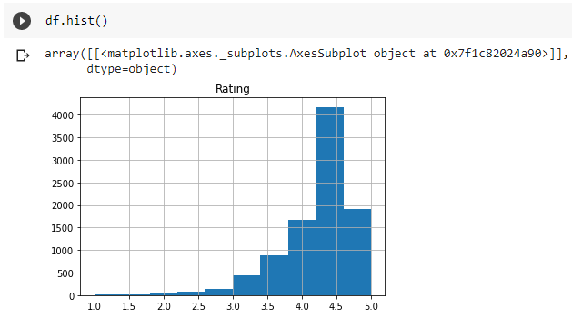
By Applying,
df[df['Rating']> 5] ,we will get rating above 5.
df.drop([10472],inplace = True)
And by dropping the row which has rating above 5 will help us to get required graph.

Slide 10
2. Data cleaning
Removing extraneous data
Filling in missing values.
Conforming data to a standardized pattern.

Slide 11
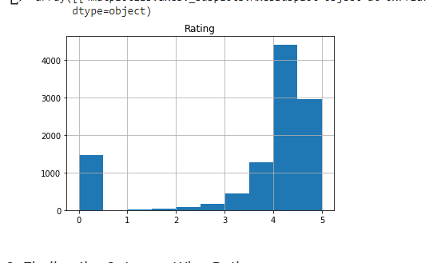
Distribution of app rating
It looks like only a small number of users take the time to write an app review. On average, somewhere between 3% and 8% of users who download an app write reviews in the Google Play Store. Our analysis has shown that users tend to leave more reviews for apps in finance, health & fitness, and business categories.

Slide 12
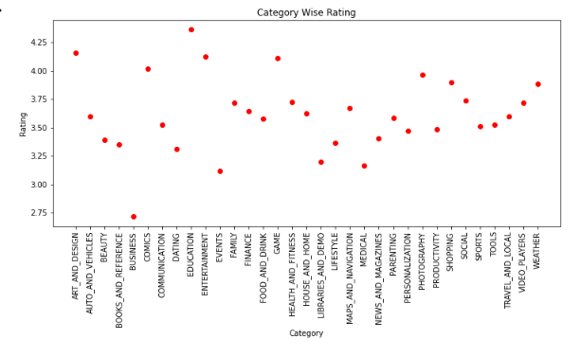
CATEGORY WISE RATING
The Family, Game and Tools Category has got the highest ratings i.e. 4 and above.

Slide 13
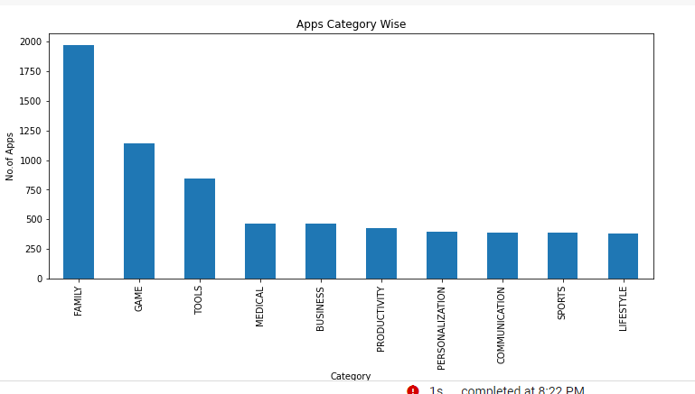
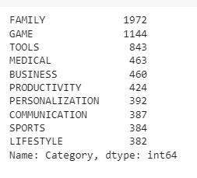
Top 10 Category of Apps and No. of Apps in each Category

Slide 14
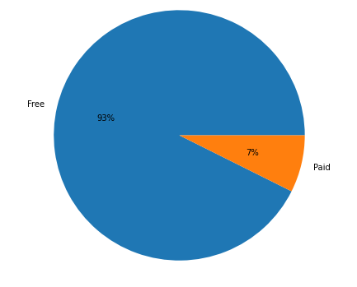
Percentage of Free and Paid Apps
Most of the apps (93%) in the Google Play Store were free to install at the time of data collection. However, 7% are paid apps. In-app purchasing refers to buying extra content or subscriptions inside an application on a mobile device. Free apps are more likely to have in-app purchases feature.

Slide 15
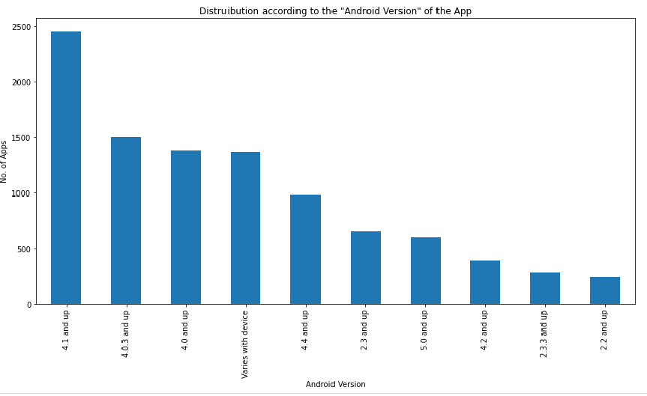
Distribution according to the "Android Version" of the App
The Android version 4.1 and above have the highest no. of apps in Dataset. Also near about 1450 apps has there Android Version which will vary as per the device.

Slide 16
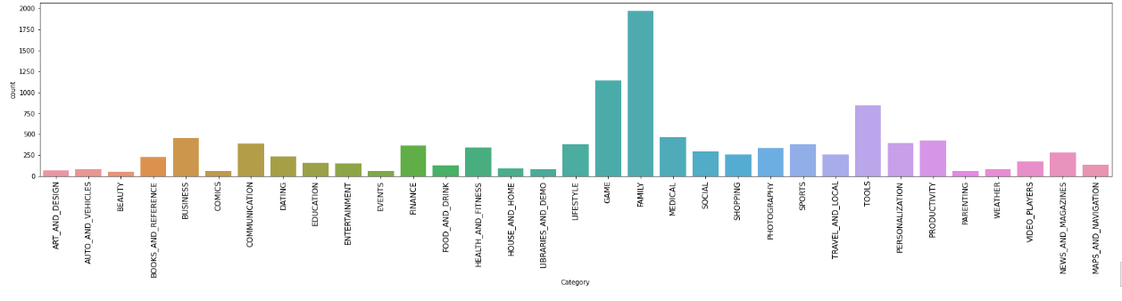
Count Plot Graph summary for no. of Apps in each Category
From the above Graph we can predict the distribution of the no. of apps in each category. Family, Game and Tools has the highest number of apps in the dataset. Though, the Category Beauty has the least no. of apps.

Slide 17
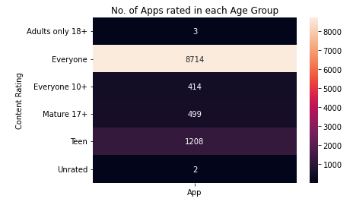
No. of Apps in Each Age Group
The apps which are available for everyone has the highest installs. However, apps which are available for teens has second highest installs. Whereas, least downloads was done for unrated apps.

Slide 18
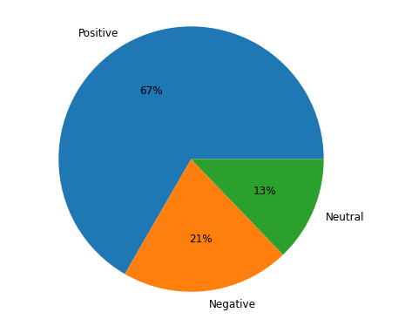
Distribution of Positive , Negative and neutral Ratings
Findings:
Positive reviews are 67%
Negative reviews are 21%
Neutral reviews are 13%

Slide 19
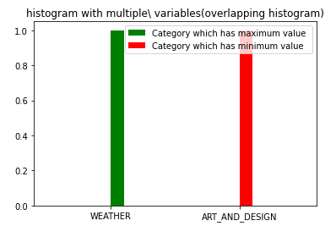
Finding maximum and minimum value of Category
We can predict that Weather has maximum values and Art and Designs has minimum values

Slide 20
Google play store Analysis project was done by group of 3 members – Shafaq Khan, Sumit Ojha and Ayush Mishra. In this project we had got 2 different csv files as an input. The csv files were play store data and user reviews. The objective of this project is to deliver insights to understand customer demands better and thus help developers to popularize the product. It is of 10k Play Store apps for analyzing the Android market. This dataset contains details of different applications and reviews from different users. In this project we analyzed the data of Google play store apps like how many number of apps are available in dataset, what is there status, there ratings, genres, reviews percentage of free and paid apps, etc. For that we used data visualization tools such as pandas ,numpy , seaborn , matplotlib. And with the help of seaborn and matpolitb we plotted the graphs and shown the distribution of apps in different age group ,percentage of free and paid apps, reviews in the apps ratings etc.
Summary

Slide 21
CONCLUSION
After undergoing these algorithms and process, we concluded that our hypothesis is true. Meaning you can predict the app ratings, however significant preprocessing must be done before you start the classification and regression processes.
The Play Store apps data has enormous potential to drive app-making businesses to success. Actionable insights can be drawn for developers to work on and capture the Android market! This shows that given the Size, Type, Price, Content Rating, and Genre of an app, we can predict about 92% accuracy if an app will have more than 100,000 installs and be a hit on the Google Play Store.
User reviews are limited to identifying polarity and subjectivity. However, the massive increase in review based data implies a requirement to focus also on performing predictions. This process is challenging yet fruitful, as user reviews are qualitative while ratings are essentially quantitative.
The numeric scoring of apps within the Google App store could also be biased and overrated because higher ratings given by users potentially attract several new users disproportionately. This study therefore investigated the utilization of ensemble classifiers to predict numeric ratings for Google Play store apps supported the user reviews for those apps. Several ensemble classifiers were investigated to gauge their performance on the reviews scraped from the Google App store

